Slide 1
How will YOU Control a BLDC Motor?
...cuz I’ll quiz you in the end for a prize…
Ken Iiyoshi
ENGR-UH 3530
Embedded Systems
Fall 2019

Slide 2
BrushLess DC Motors

Slide 3
video
See GitHub video titled “bldc_motor_close”

Slide 4
Why bother?
Modern alternative to brushed DC Motors (est. 1830s)
1970s semiconductor electronics replaced commutators.
ex) MOSFETs
Source: en.wikipedia.org/wiki/Brushless_DC_electric_motor

Slide 5
So?
Less dependence on mechanical parts
Higher torque-per-watt/weight
Still dominant in most industry
Source: en.wikipedia.org/wiki/Brushless_DC_electric_motor

Slide 6

Cool Application?
Dental Drills
Fast
Light
Quiet
Less whir
Long-lasting
Less sparks
Small
mm diameter!
Source: https://www.kdedirect.com/blogs/news/6-industry-applications-brushless-motors

Slide 7

Notes:
0:21 ~ 2:34. How the motor is powered & why it has 3 inputs

Slide 8
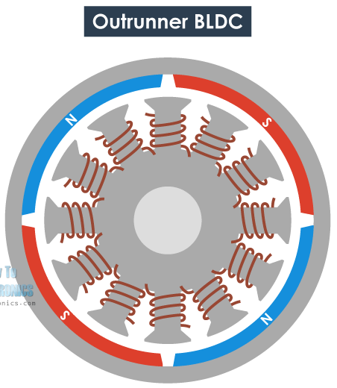
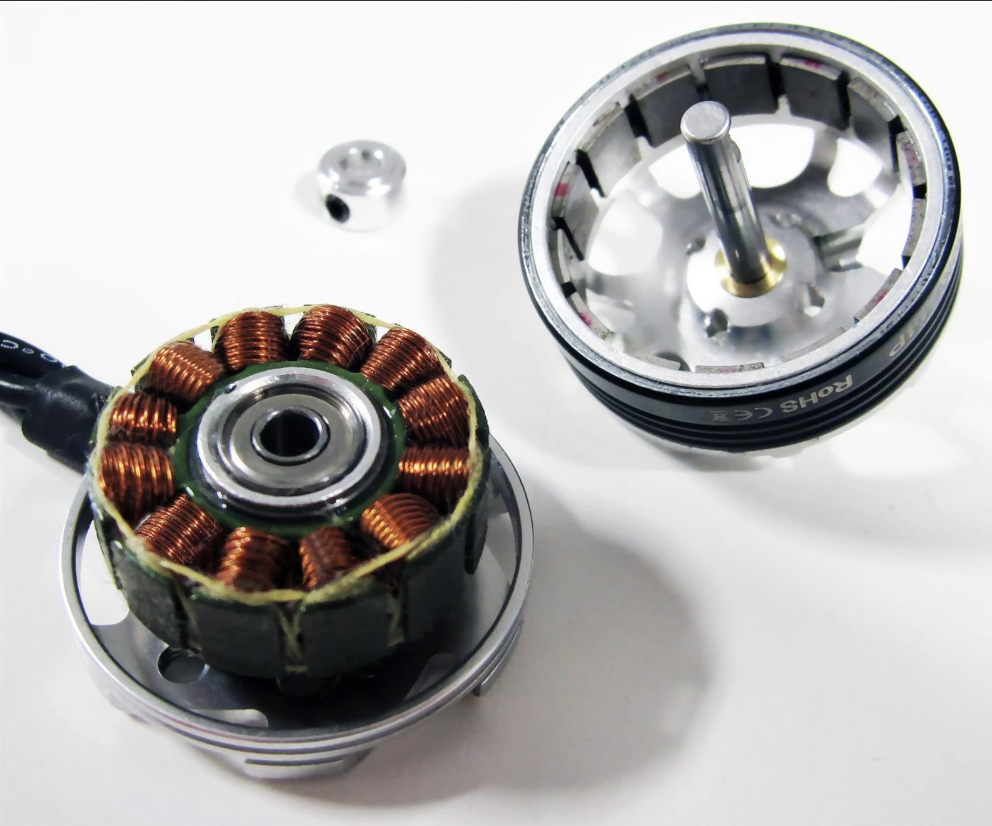
Actual Design
Source: https://www.kdedirect.com/products/kde2306xf-2050?variant=866065623

Slide 9
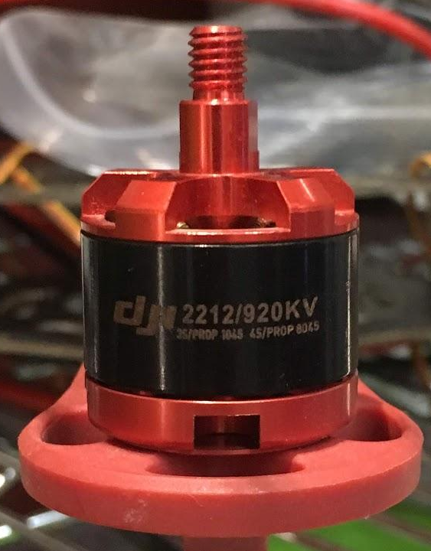
How Fast is it?
Motor Datasheets specifies RPM per Voltage
Ex)
920KV motor
10V Supply
920 * 10 = 9200 RPM!

Slide 10
Don’t go too fast!
Overheating motor shaft: BAD
Excessive voltage
Long operation
1 ~ 2min without propellers
Lack of load
ex) no propellers

Slide 11
How Expensive is it?
The 920KV Motor: $10~30
More than Brushed DC Motors
https://www.ato.com/brushless-dc-motor-price-list
Industrial motors from Chinese manufacturers
High Torque BLDC Motor
Max $2500: 2000 rpm, 50 Nm
High Speed BLDC Motor
Max $350: 17000 rpm without load
Min price on Amazon: $8

Slide 12
How Heavy/Big is it?
The 920KV Motor: 53g, few cubic inches
High
MP154120 RC Motor
for electric cars
6kg, Ø200 mm diameter, 8cm thick
Low
Maxon Motor EC 10
For high precision medical & aerospace app
13 g, Ø10 mm, 25.7mm thick

Slide 13
How do I activate each phase?

Slide 14
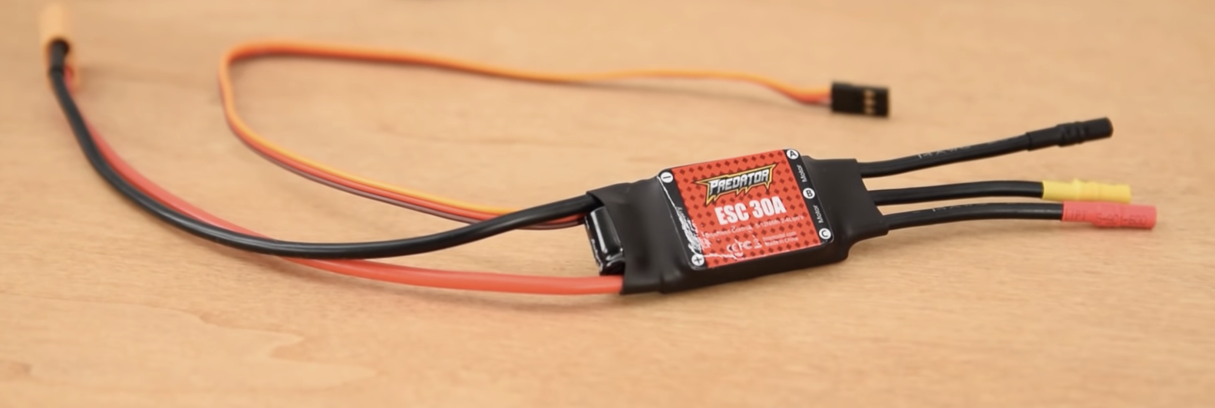
ESC
Source: https://howtomechatronics.com/how-it-works/how-brushless-motor-and-esc-work/

Slide 15
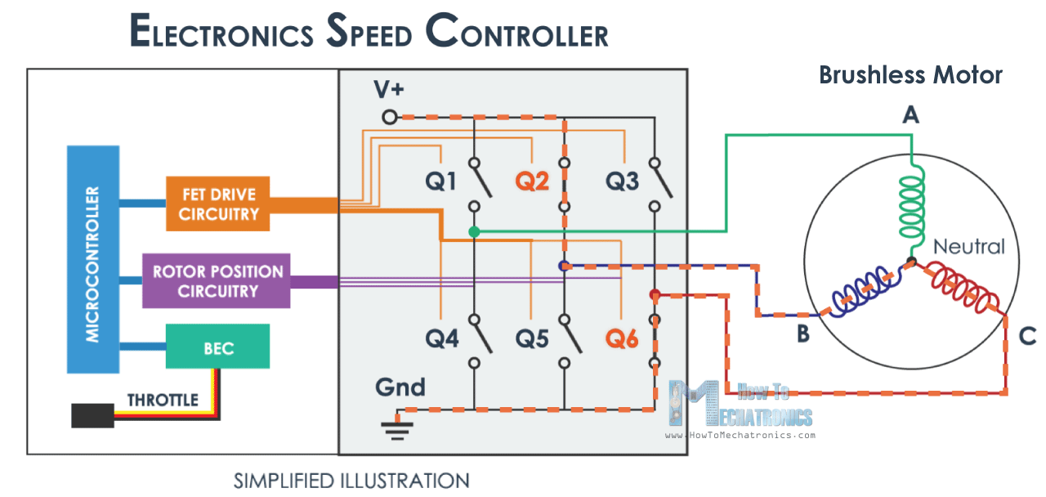
*alternative: optoisolator
*
**
**MOSFETs, like H Bridge
Source: https://howtomechatronics.com/how-it-works/how-brushless-motor-and-esc-work/

Slide 16
How Expensive is it?
One I used: $70
Amazon.com
Max $400 (Hobbywing - For RC boat)
Min $22 (Hobbywing - waterproof)

Slide 17
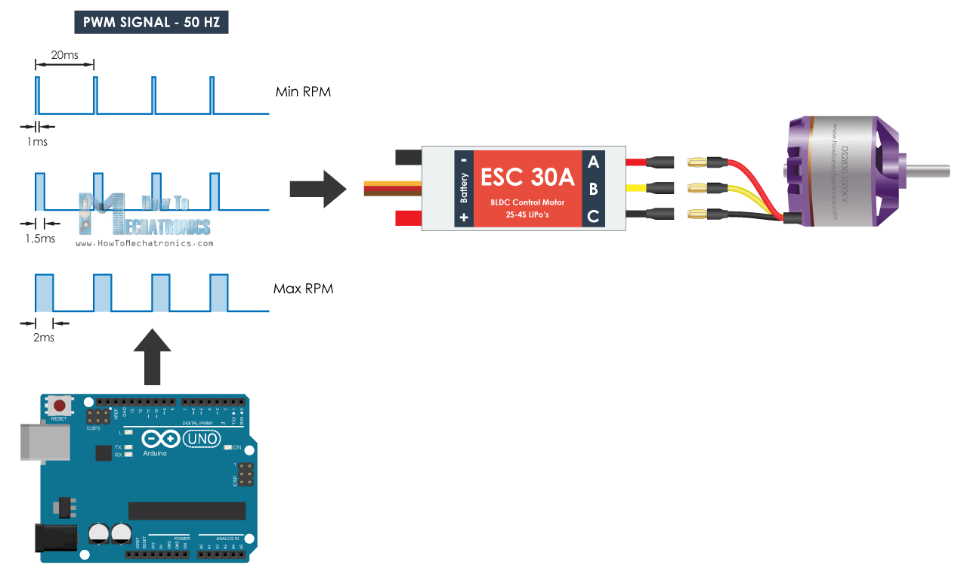
ESC I/O?
Source: https://howtomechatronics.com/how-it-works/how-brushless-motor-and-esc-work/

Slide 18
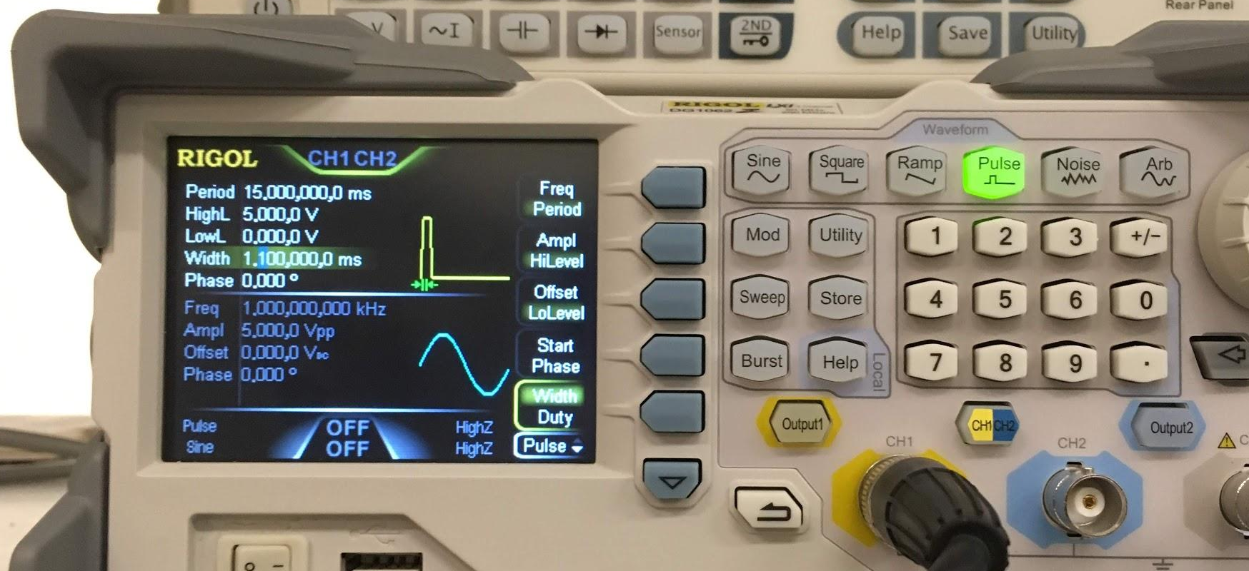
ESC example input ?

Slide 19
video
See GitHub video titled “signal”

Slide 20
Output Compare PWM

Slide 21
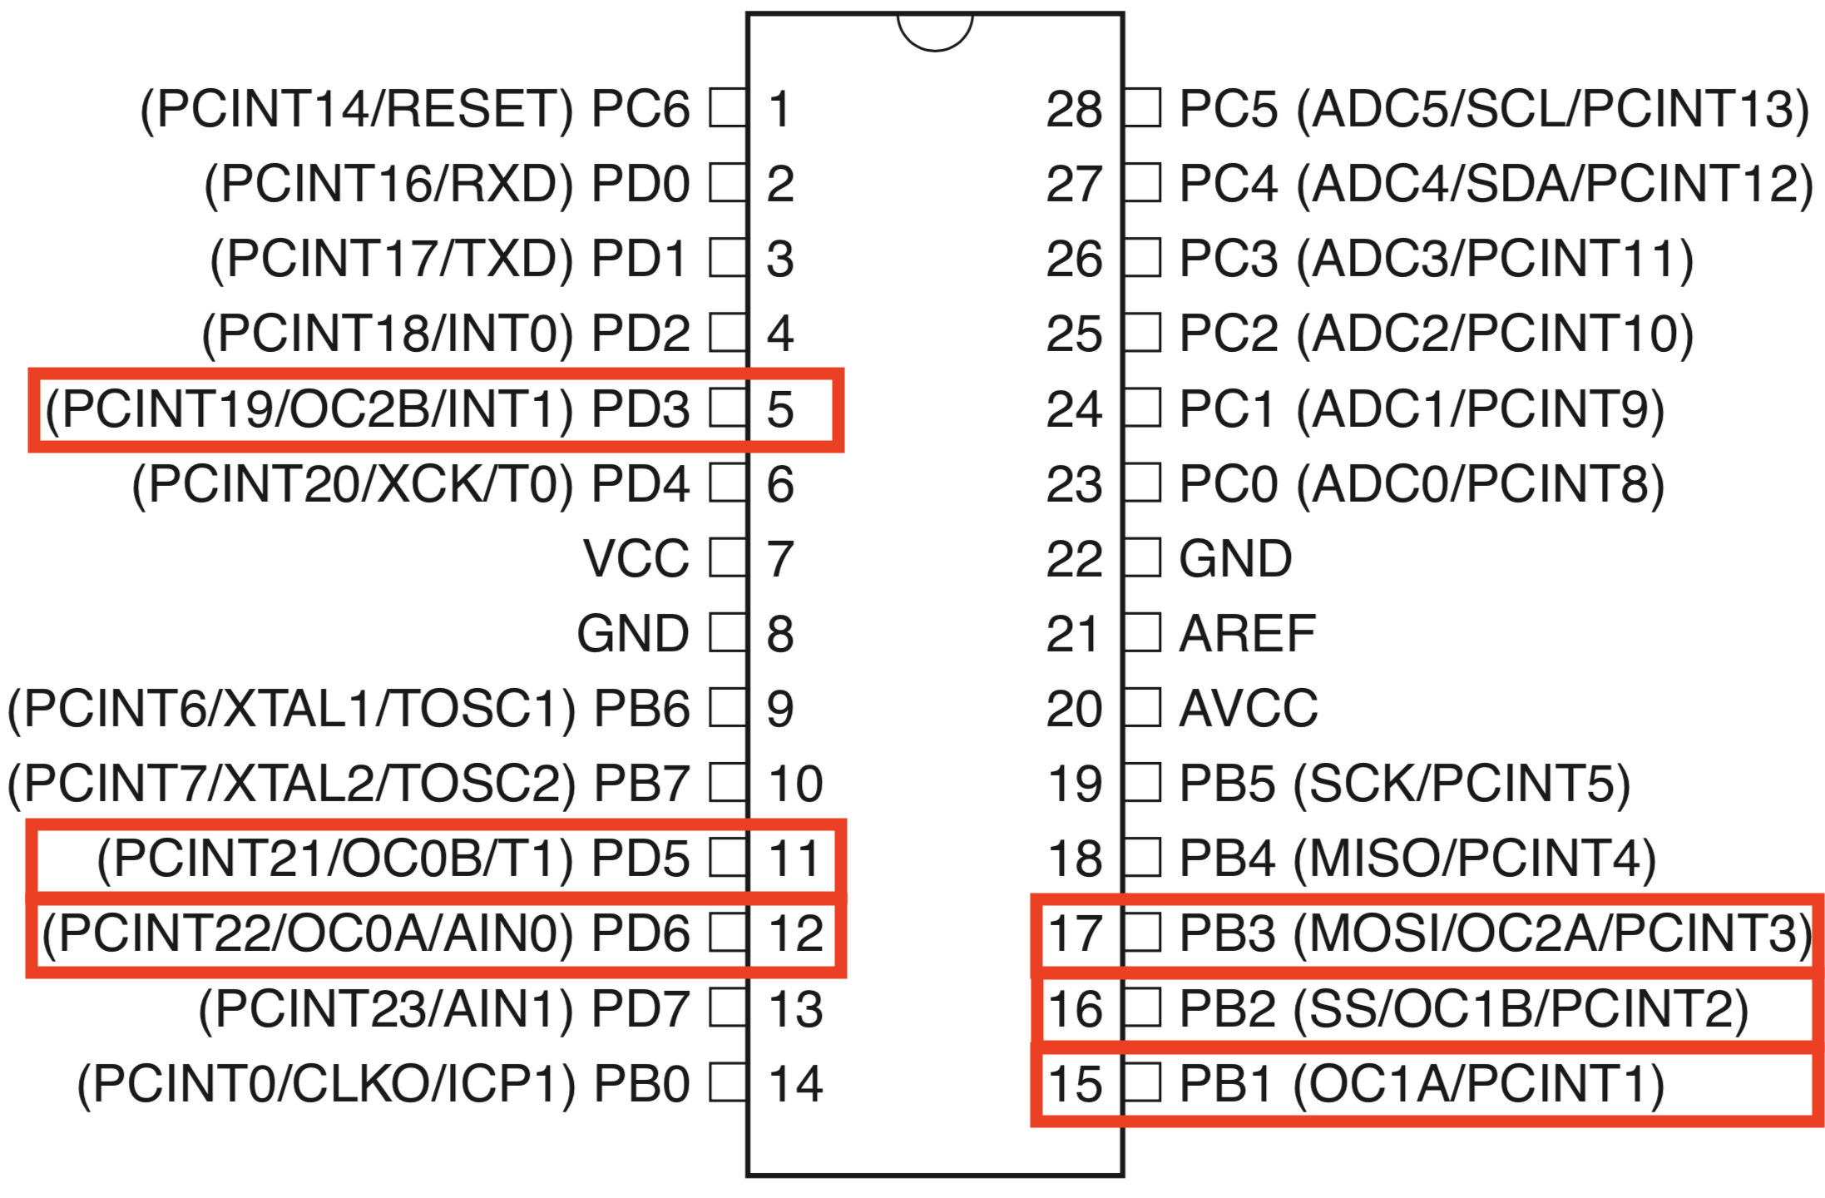
Which pins are for OC PWM?

Slide 22
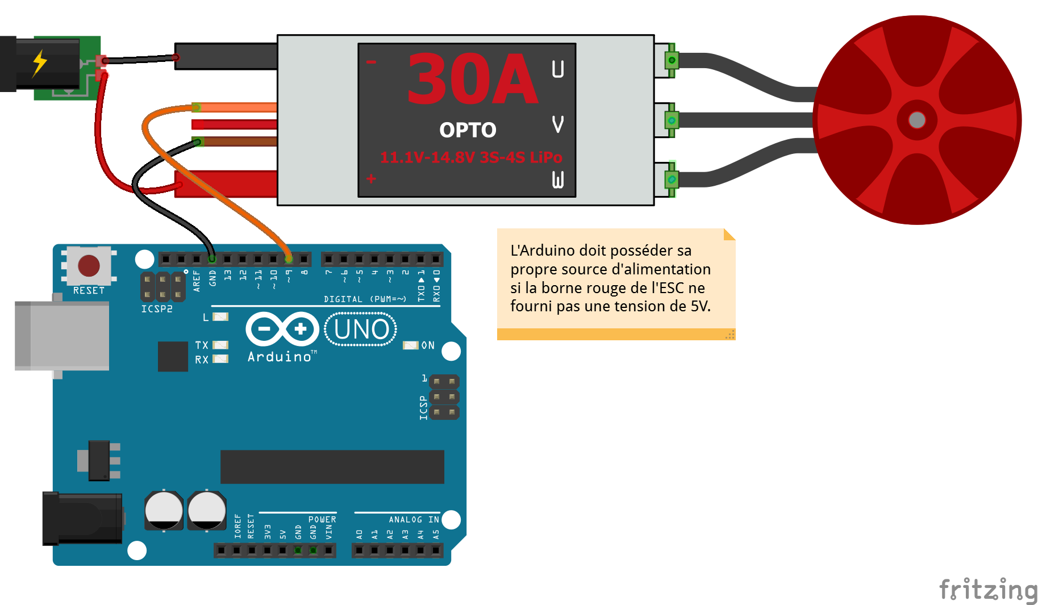
Pin-out for BLDC Motor
Source: http://arduino.blaisepascal.fr/controler-un-moteur-brushless/

Slide 23
Code for BLDC Motor
#define F_CPU 16000000ul
#include <avr/io.h>
#include <util/delay.h>
#include <avr/interrupt.h>
int main(void)
{
DDRB |= (1 << PINB1); // Set OC1A (Pin 9) as output
PORTB &= ~(1 << PINB1);
_delay_ms(10000); // Gives me 10 s to start the DC supply
TCNT1 = 0; // Initialize TCNT1
ICR1 = 4999; // 50 Hz PWM = 16MHz / ( 64 * ( 1 + 4999 ) )
// clk/64, set fast PWM, TOP in ICR1, Clear OC1A on compare match (non-inverting)
TCCR1A = (1<<COM1A1) | (1<<WGM11);
TCCR1B = (1<<WGM13) | (1<<WGM12) | (1<<CS11) | (1<<CS10);
OCR1A = 40; // (40/5000) * 20 ms = 0.16 ms. < 1ms to arm the BLDC motor
_delay_ms(5000); // 5 seconds buffer time.
while(1) {
OCR1A = 120; // (120/5000) * 20 ms = 0.48 ms
_delay_ms(3000);
OCR1A = 350; // (350/5000) * 20 ms = 1.4 ms
_delay_ms(3000);
OCR1A = 600; // (600/5000) * 20 ms = 2.4 ms
_delay_ms(3000);
}
}
*Arming of the ESC

Slide 24
video
See GitHub video titled “run_motor”

Slide 25
How can I control BLDC Speed?
There are several ways for ATMega328P
Analog:
Potentiometer via ADC
imagine controlling RC toy cars
Digital
Hard code
Independent Program
imagine autonomous drones

Slide 26
Which pins are for ADC?

Slide 27
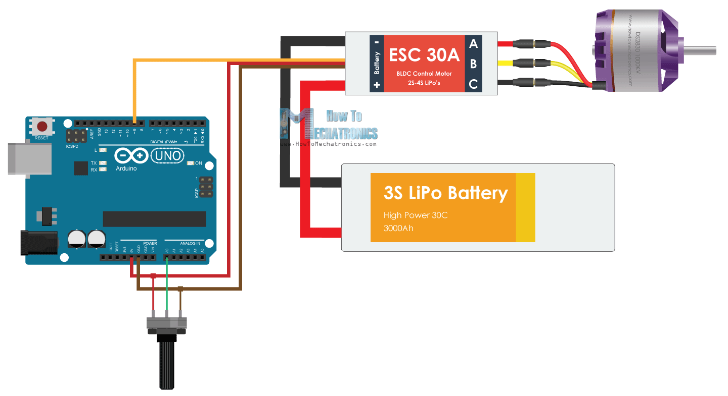
Pin-out for potentiometer
*Start @ max θ˚ for ESC Calibration
Source: https://howtomechatronics.com/tutorials/arduino/arduino-brushless-motor-control-tutorial-esc-bldc/

Slide 28
Code for potentiometer
#define F_CPU 16000000ul
#include <avr/io.h>
#include <util/delay.h>
#include <avr/interrupt.h>
int main(void)
{
ADC_Init();
DDRB |= (1 << PINB1); // Set OC1A (Pin 9) as output
PORTB &= ~(1 << PINB1);
_delay_ms(10000); // Gives me time to start the DC supply
TCNT1 = 0; // Initialize TCNT1
ICR1 = 4999; // 50 Hz PWM = 16MHz / (64*(1+4999))
// clk/64, set fast PWM, TOP in ICR1, Clear OC1A on compare match (non-inverting)
TCCR1A = (1<<COM1A1) | (1<<WGM11);
TCCR1B = (1<<WGM13) | (1<<WGM12) | (1<<CS11) | (1<<CS10);
OCR1A = 40; // 0.8 ms. < 1ms to arm the BLDC motor
_delay_ms(2000); // 5 seconds buffer time.
// Read ADC0. Between 120-600 (2.4-12 ms pulse)
while(1) OCR1A = 120 + (ADC0_Read()/3.0);
}
void ADC_Init()
{
DDRC=0x00; //Make ADC port as input
// Enable ADC, with freq/128 now 2
ADCSRA = (1 << ADEN) | (1 << ADPS2) | (1 << ADPS1) | (1 << ADPS0);
// AVcc as Reference voltage, ADC0 as input
ADMUX = (1 << REFS0);
}
int ADC0_Read()
{
ADMUX = (1 << REFS0); // Set ADC0 to read
ADCSRA |= (1<<ADSC); // Start ADC conversion
// Wait until end of conversion by polling ADC interrupt flag
while (!(ADCSRA & (1<<ADIF)));
ADCSRA |= (1<<ADIF); // Clear interrupt flag
_delay_ms(1); // Wait a little bit
return ADCW; // Return ADC data register
}

Slide 29
video
See GitHub video titled “motor_adc”

Slide 30
Quiz Time!
Why use a BLDC Motor?
How expensive is BLDC Motor & ESC?
How Heavy/Big can a BLDC Motor be?
How do you activate each phase in a BLDC Motor?
What should be inputted into ESC?

Slide 31
REFERENCES
en.wikipedia.org/wiki/Brushless_DC_electric_motor
https://howtomechatronics.com/how-it-works/how-servo-motors-work-how-to-control-servos-using-arduino/
https://www.electronicwings.com/avr-atmega/servo-motor-interfacing-with-atmega16
Jeremy Fielding’s Youtube Video on DC motors
Datasheets
dji ESC 30A opto
dji 2212 920KV Brushless Motor
ATMega328P
https://www.kdedirect.com/blogs/news/6-industry-applications-brushless-motors

Slide 32
Appendix A Chp. 16 Diagrams

Slide 33
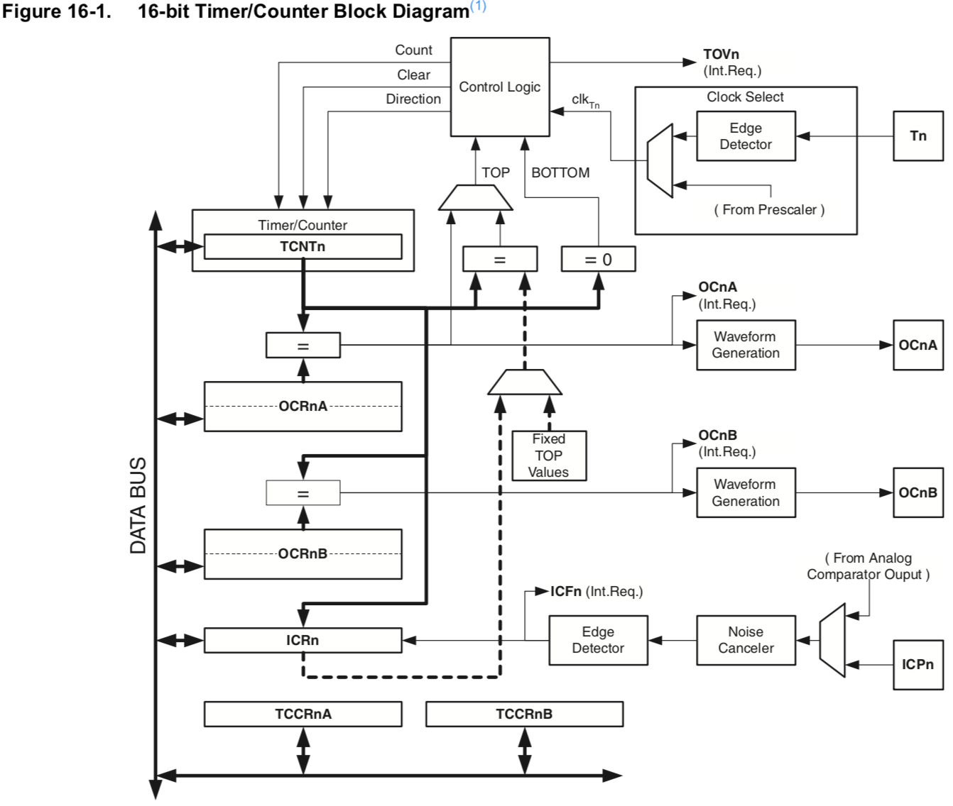

Slide 34
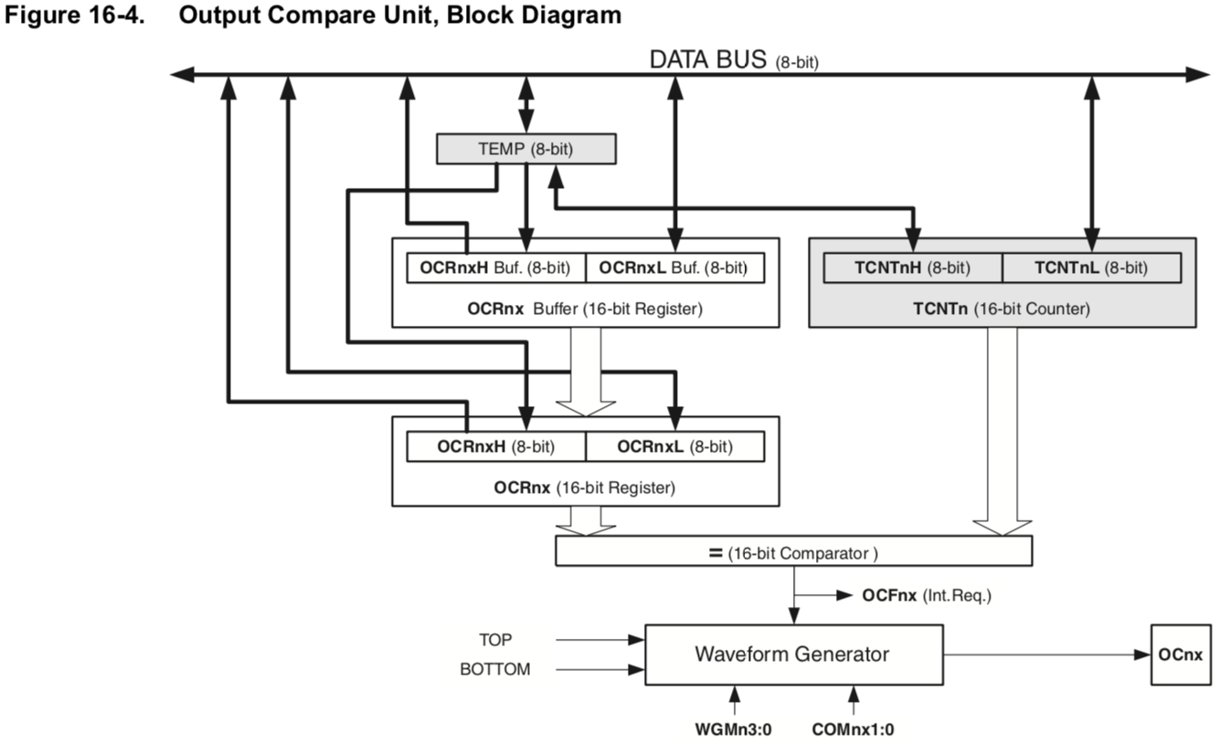

Slide 35
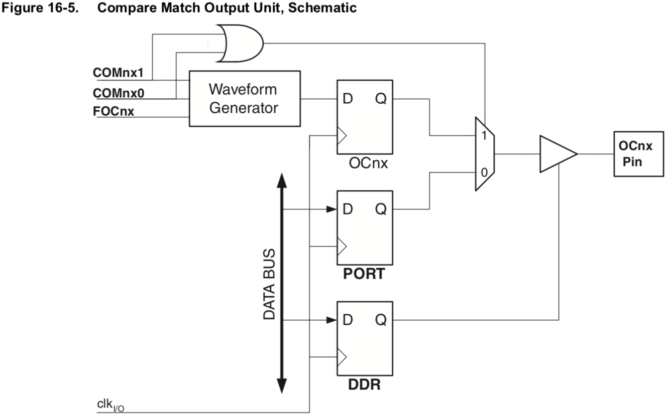

Slide 36
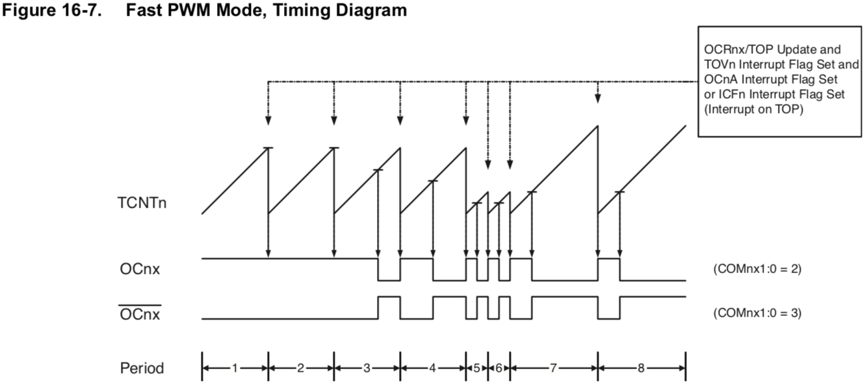

Slide 37
16.9.3 Fast PWM Mode (Summary)
Due to the single-slope operation, the operating frequency of the fast PWM mode can be twice as high as the phase correct and phase and frequency correct PWM modes that use dual-slope operation. This high frequency makes the fast PWM mode well suited for power regulation, rectification, and DAC applications. High frequency allows physically small sized external components (coils, capacitors), hence reduces total system cost.
The PWM resolution for fast PWM can be fixed to 8-, 9-, or 10-bit, or defined by either ICR1 or OCR1A. The minimum resolution allowed is 2-bit (ICR1 or OCR1A set to 0x0003), and the maximum resolution is 16-bit (ICR1 or OCR1A set to MAX).
In fast PWM mode the counter is incremented until the counter value matches either one of the fixed values 0x00FF, 0x01FF, or 0x03FF (WGM13:0 = 5, 6, or 7), the value in ICR1 (WGM13:0 = 14), or the value in OCR1A (WGM13:0 = 15). The counter is then cleared at the following timer clock cycle.
In addition the OC1A or ICF1 Flag is set at the same timer clock cycle as TOV1 is set when either OCR1A or ICR1 is used for defining the TOP value. If one of the interrupts are enabled, the interrupt handler routine can be used for updating the TOP and compare values.
When changing the TOP value the program must ensure that the new TOP value is higher or equal to the value of all of the Compare Registers. If the TOP value is lower than any of the Compare Registers, a compare match will never occur between the TCNT1 and the OCR1x. Note that when using fixed TOP values the unused bits are masked to zero when any of the OCR1x Registers are written.
The procedure for updating ICR1 differs from updating OCR1A when used for defining the TOP value. The ICR1 Register is not double buffered. This means that if ICR1 is changed to a low value when the counter is running with none or a low prescaler value, there is a risk that the new ICR1 value written is lower than the current value of TCNT1. The result will then be that the counter will miss the compare match at the TOP value. The counter will then have to count to the MAX value (0xFFFF) and wrap around starting at 0x0000 before the compare match can occur. The OCR1A Register however, is double buffered. This feature allows the OCR1A I/O location to be written anytime. When the OCR1A I/O location is written the value written will be put into the OCR1A Buffer Register. The OCR1A Compare Register will then be updated with the value in the Buffer Register at the next timer clock cycle the TCNT1 matches TOP. The update is done at the same timer clock cycle as the TCNT1 is cleared and the TOV1 Flag is set.
Using the ICR1 Register for defining TOP works well when using fixed TOP values. By using ICR1, the OCR1A Register is free to be used for generating a PWM output on OC1A. However, if the base PWM frequency is actively changed (by changing the TOP value), using the OCR1A as TOP is clearly a better choice due to its double buffer feature.
The extreme values for the OCR1x Register represents special cases when generating a PWM waveform output in the fast PWM mode. If the OCR1x is set equal to BOTTOM (0x0000) the output will be a narrow spike for each TOP+1 timer clock cycle. Setting the OCR1x equal to TOP will result in a constant high or low output (depending on the polarity of the output set by the COM1x1:0 bits.)

Slide 38
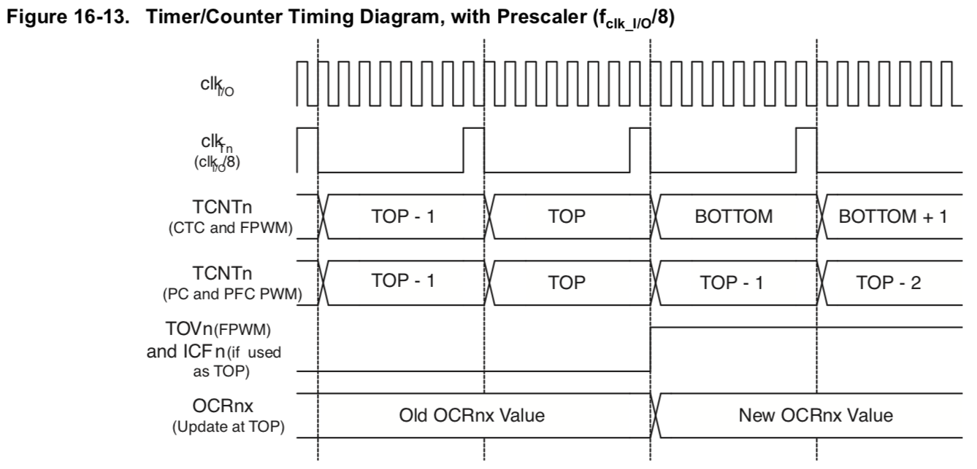

Slide 39
Appendix B Chp. 24 Diagrams

Slide 40
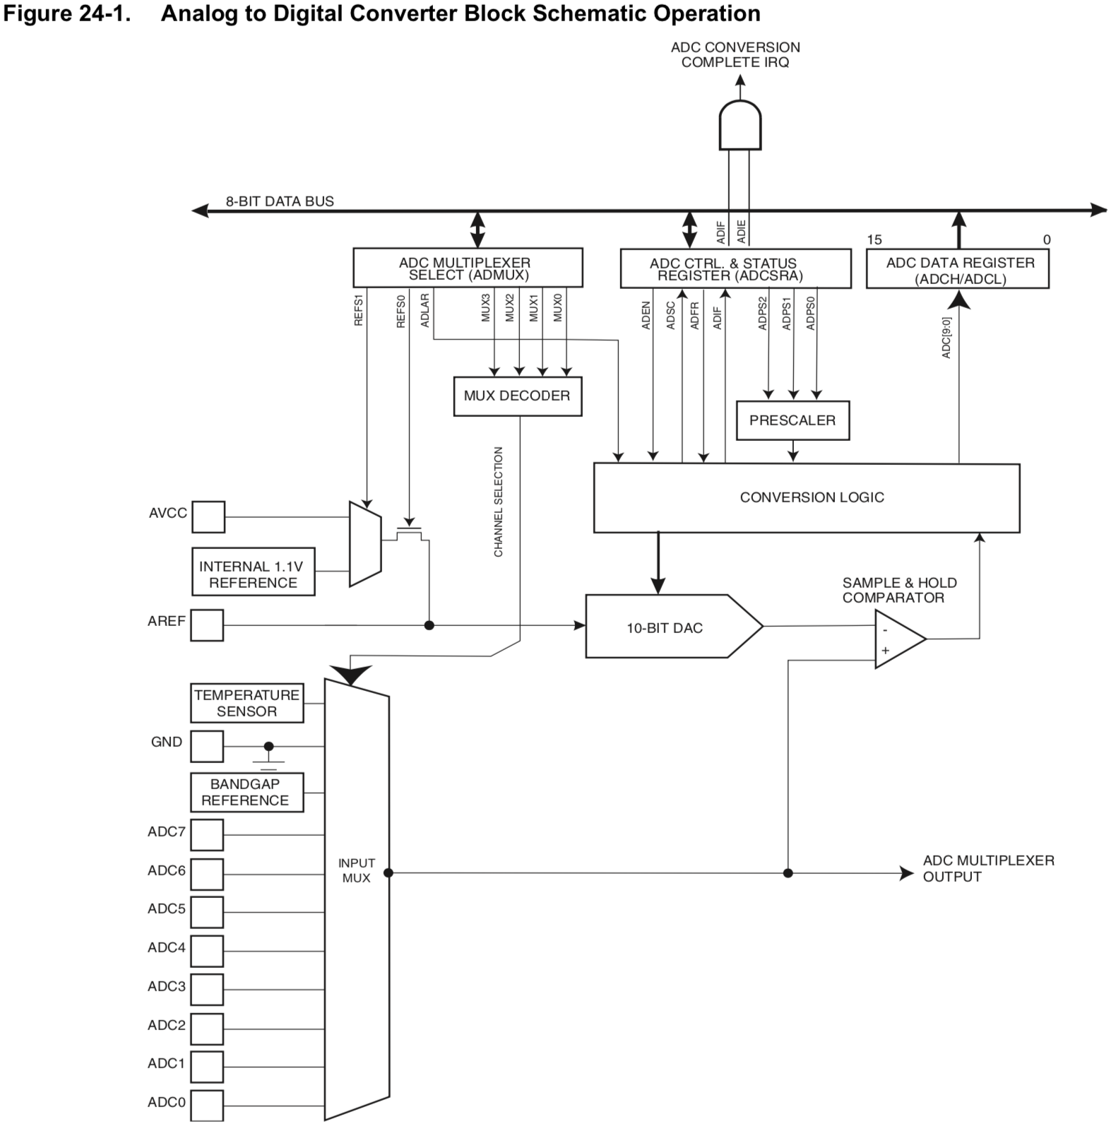

Slide 41
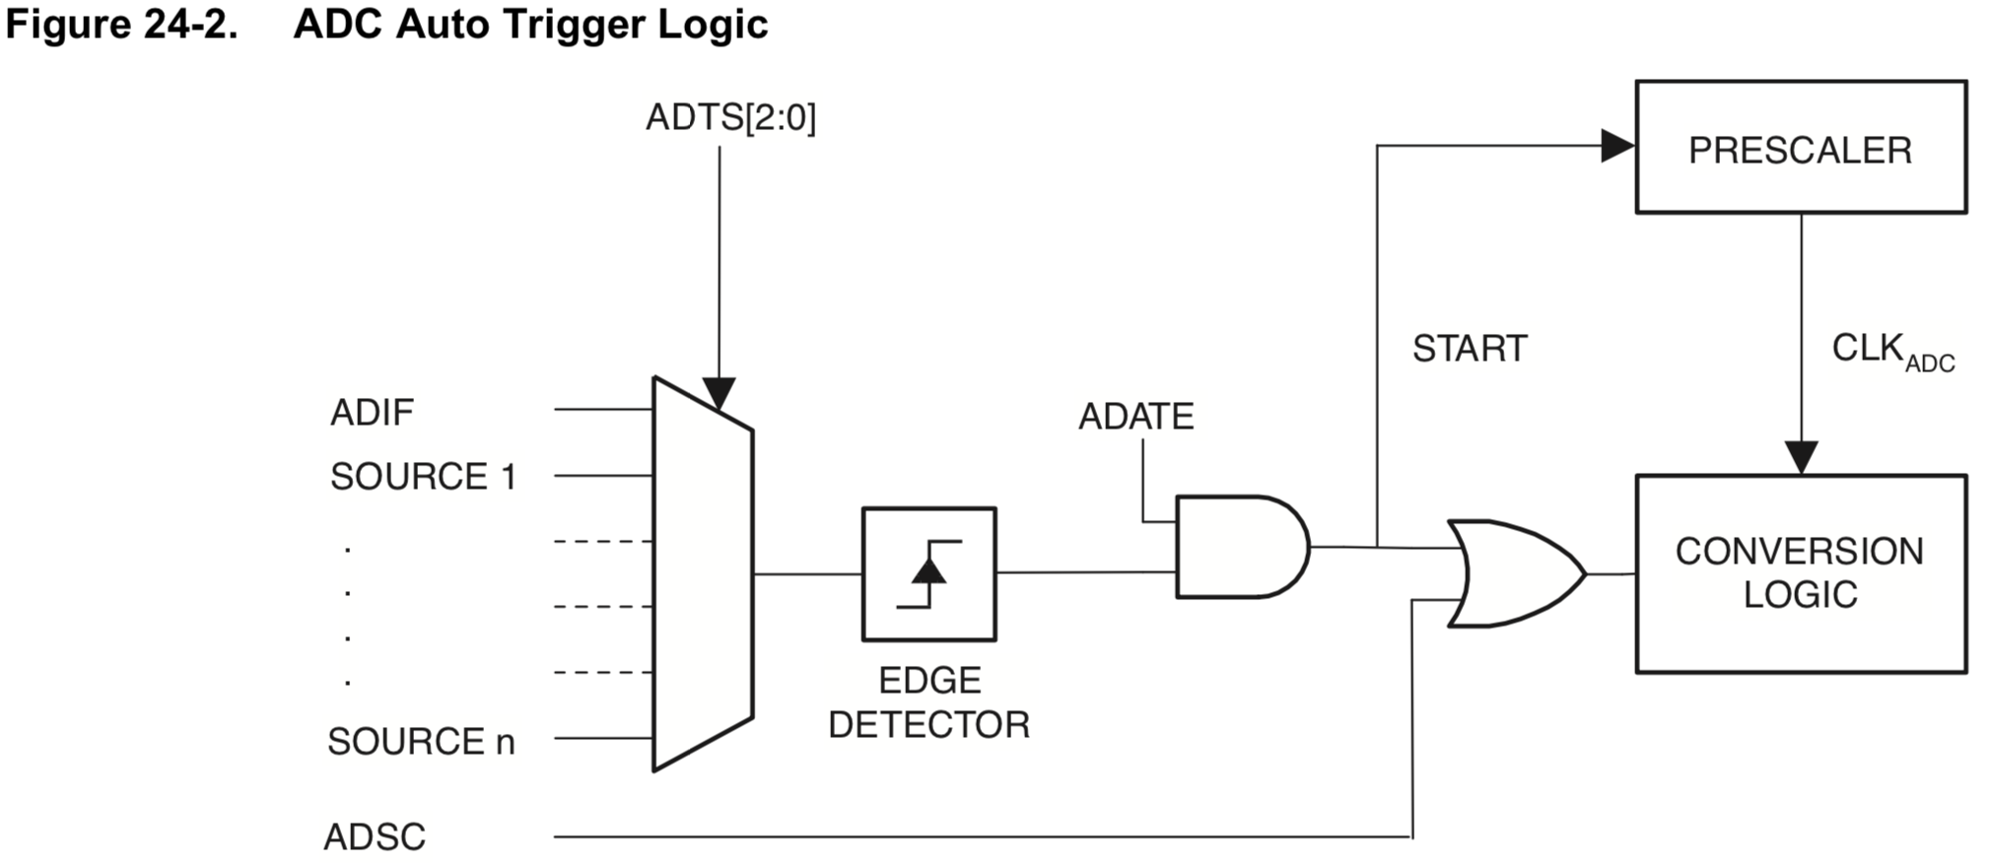

Slide 42
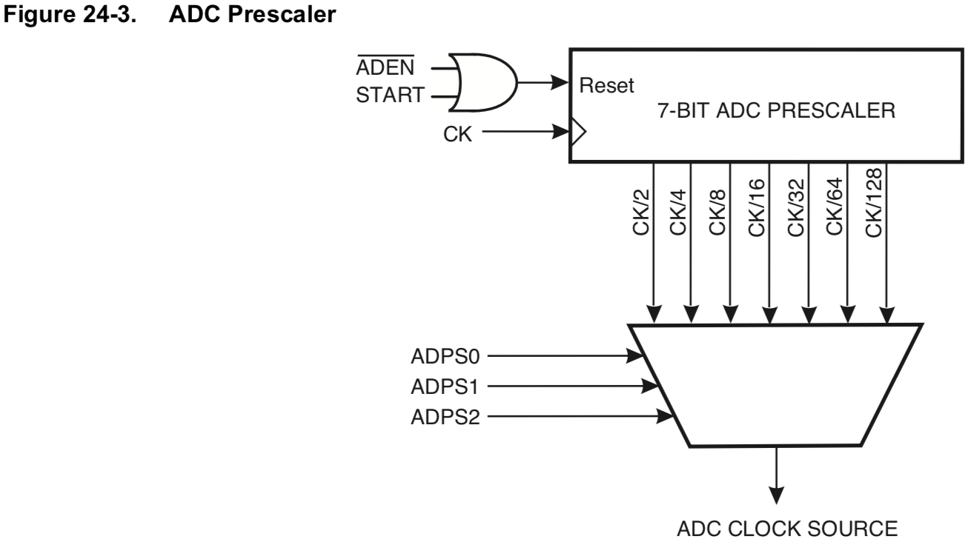

Slide 43
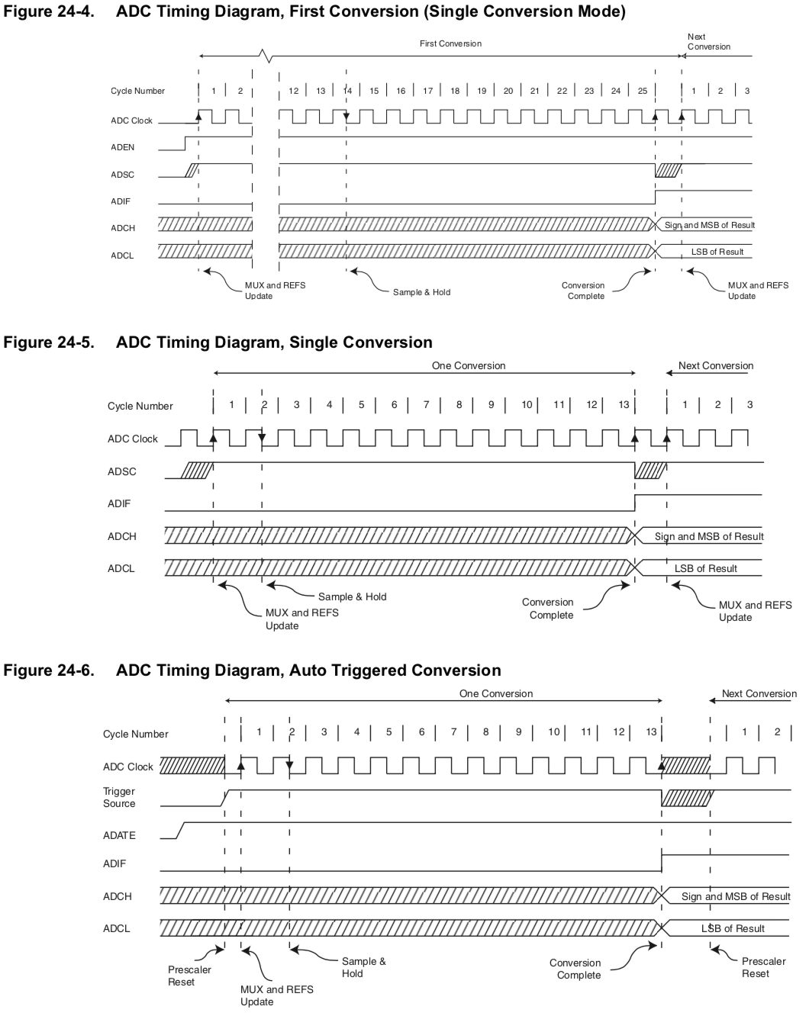

Slide 44
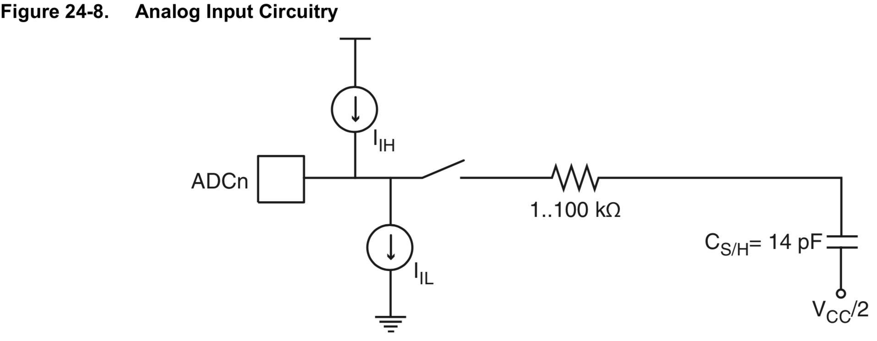

Slide 45
